Slide 1
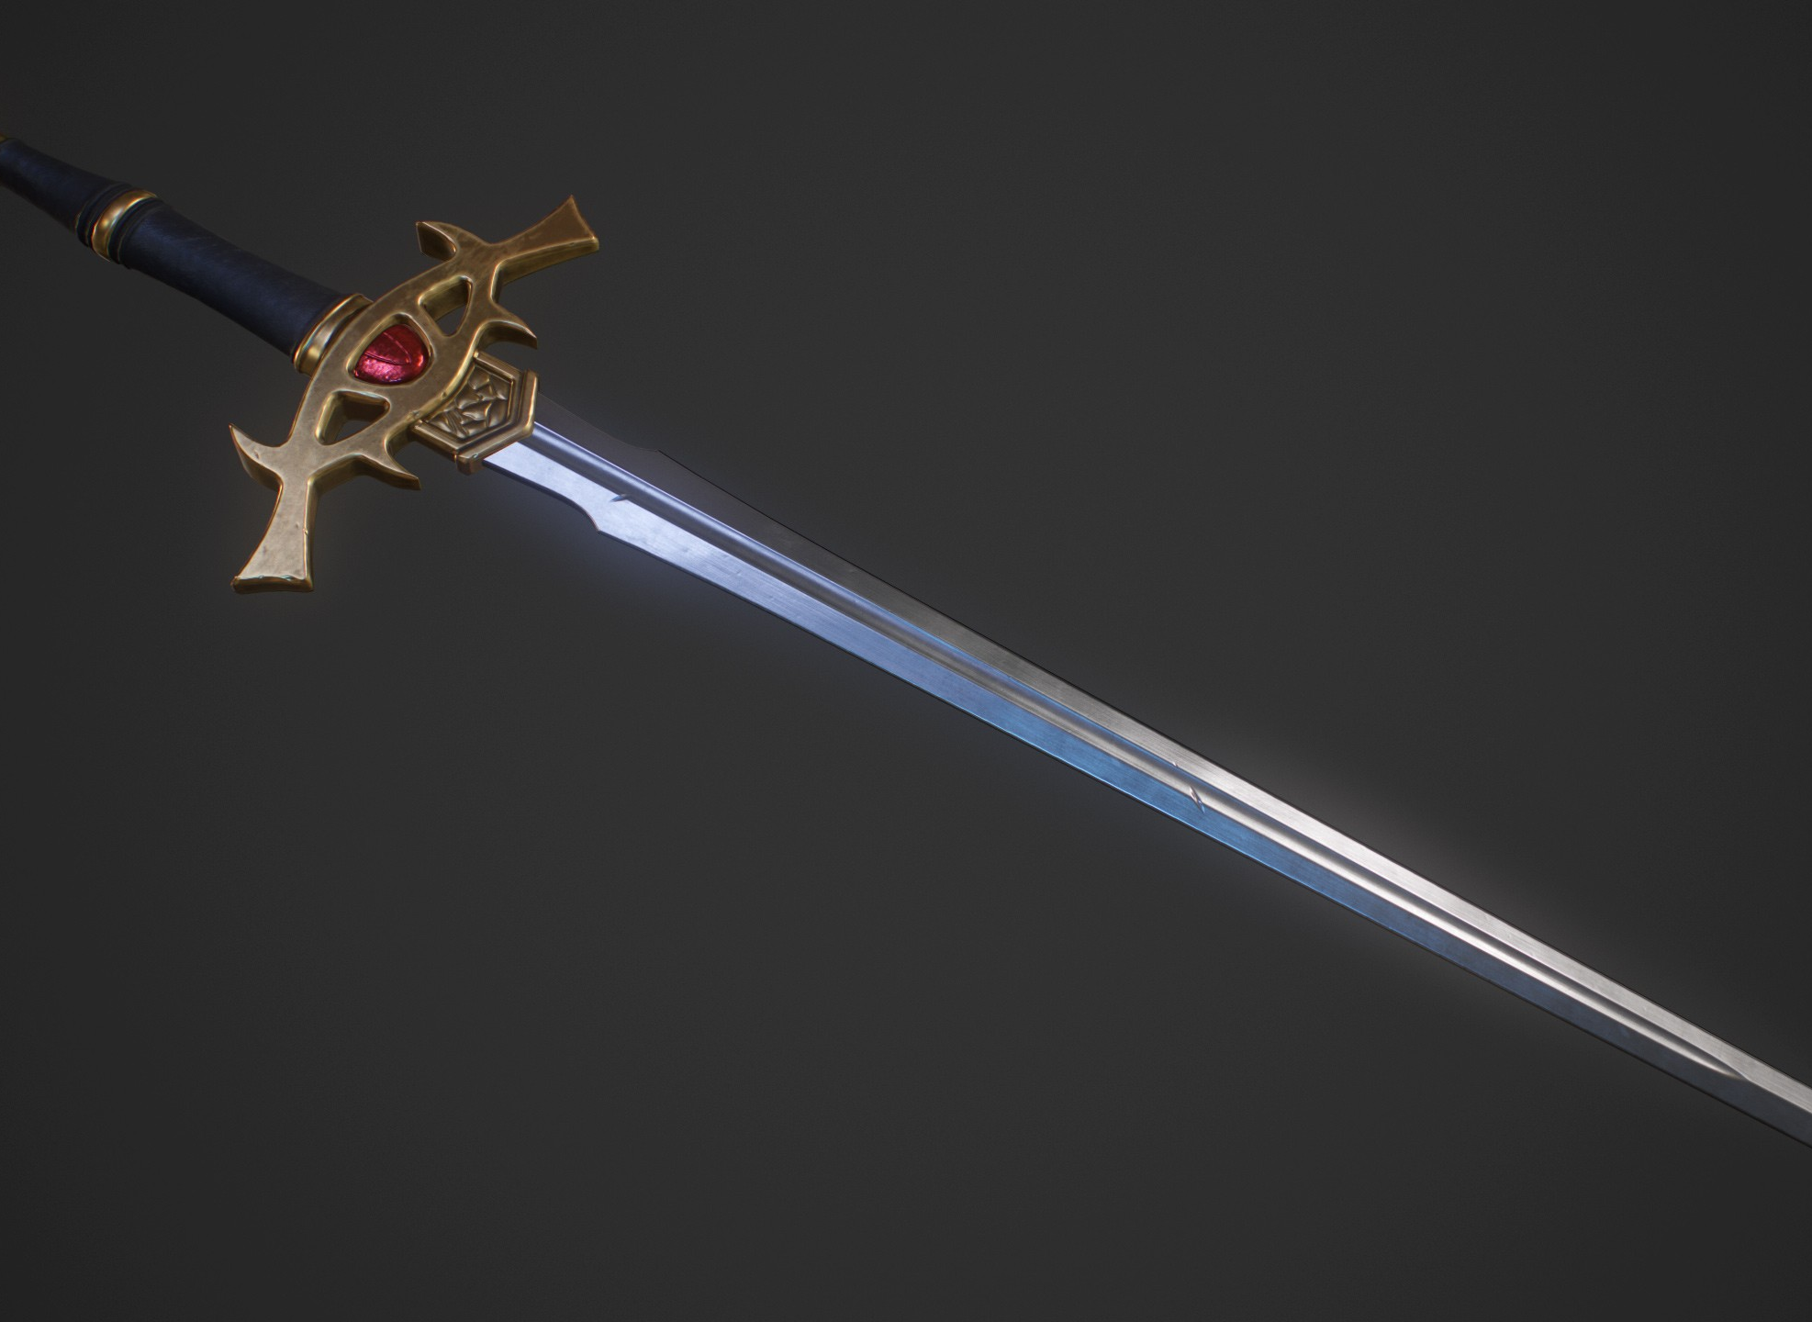
Sharpen Your Sword Through the Bible From Genesis - Revelation
Lesson 7
This Photo by Unknown Author is licensed under CC BY-NC-ND

Slide 2
Read Job 14-33

Slide 3
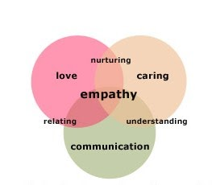
Eliphaz Bildad Zophar—Common Traits
Job’s friends lack ability to walk in his shoes
Continue to point out Job’s faults
Try to explain Job’s suffering
Spiritually uninformed
This Photo by Unknown Author is licensed under CC BY

Slide 4
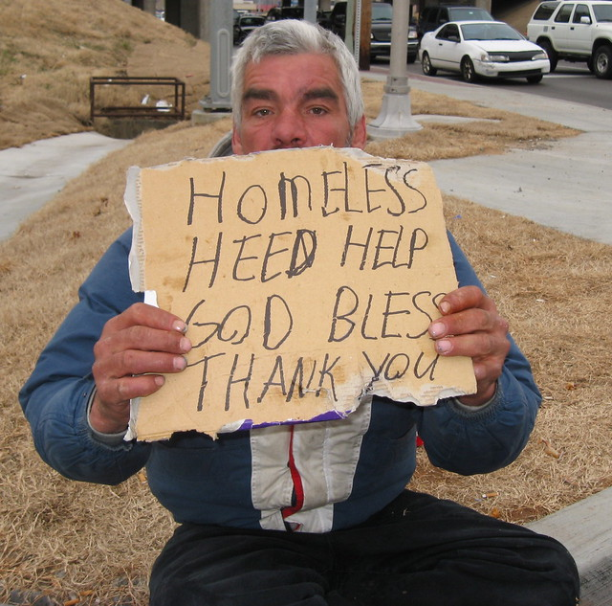
Eliphaz
Makes up charges against Job
Job 22:5 failed to give drink to the thirsty
Job 22:8 did not feed the hungry
Job 22:9 did not care for widow or orphan
Jesus said that we have a responsibility to: Matthew 25:35-40
This Photo by Unknown Author is licensed under CC BY

Slide 5
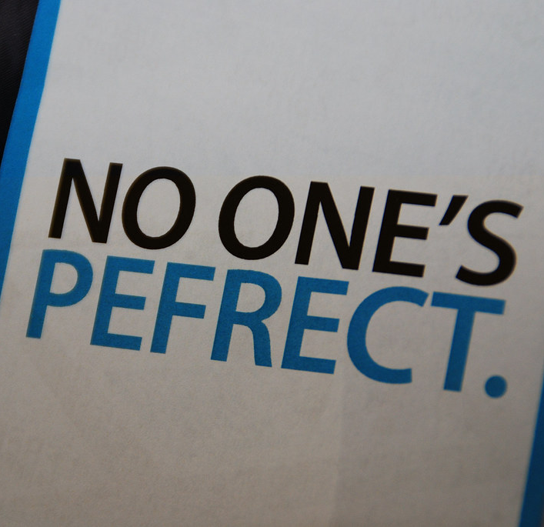
Bildad
Job is unrighteous
Job 18, God punishes the wicked so obviously Job did something wrong
Job 25 No one born is right in God’s sight
This Photo by Unknown Author is licensed under CC BY-NC-ND

Slide 6
Zophar
Job will not enjoy his wealth due to his wickedness
Job 20:15 riches not enjoyed but make sick to stomach
Job 20:18 will not enjoy the fruit of his work
Job 20:19 wealth came because he stole from others
Luke 12:16-20
This Photo by Unknown Author is licensed under CC BY-SA-NC

Slide 7
Job’s response
Job 14:7-17: suffering should have meaning
Job 16:18-22: believes there is a mediator between humans and God
Job 19:23-27: raises possibility of resurrection
Job 21:7-9, 29-33: wicked can proper
Job 23:8-17: desires to see God
Job 26:6-7: he will see God after he dires
This Photo by Unknown Author is licensed under CC BY-NC-ND

Slide 8
Reflection Questions
This Photo by Unknown Author is licensed under CC BY-SA
How would explain Job’s suffering to him?
Why do good people experience hard trials?
Why do the wicked prosper on earth?
What would you say to someone going through suffering?
What do you think is going on when God is quiet?

Slide 9
Meditation
Sovereign
https://www.youtube.com/watch?v=3ApSojVuYYc
Think about God and the world, the country, your life as you listen to this song
This Photo by Unknown Author is licensed under CC BY-NC

